Slide 1
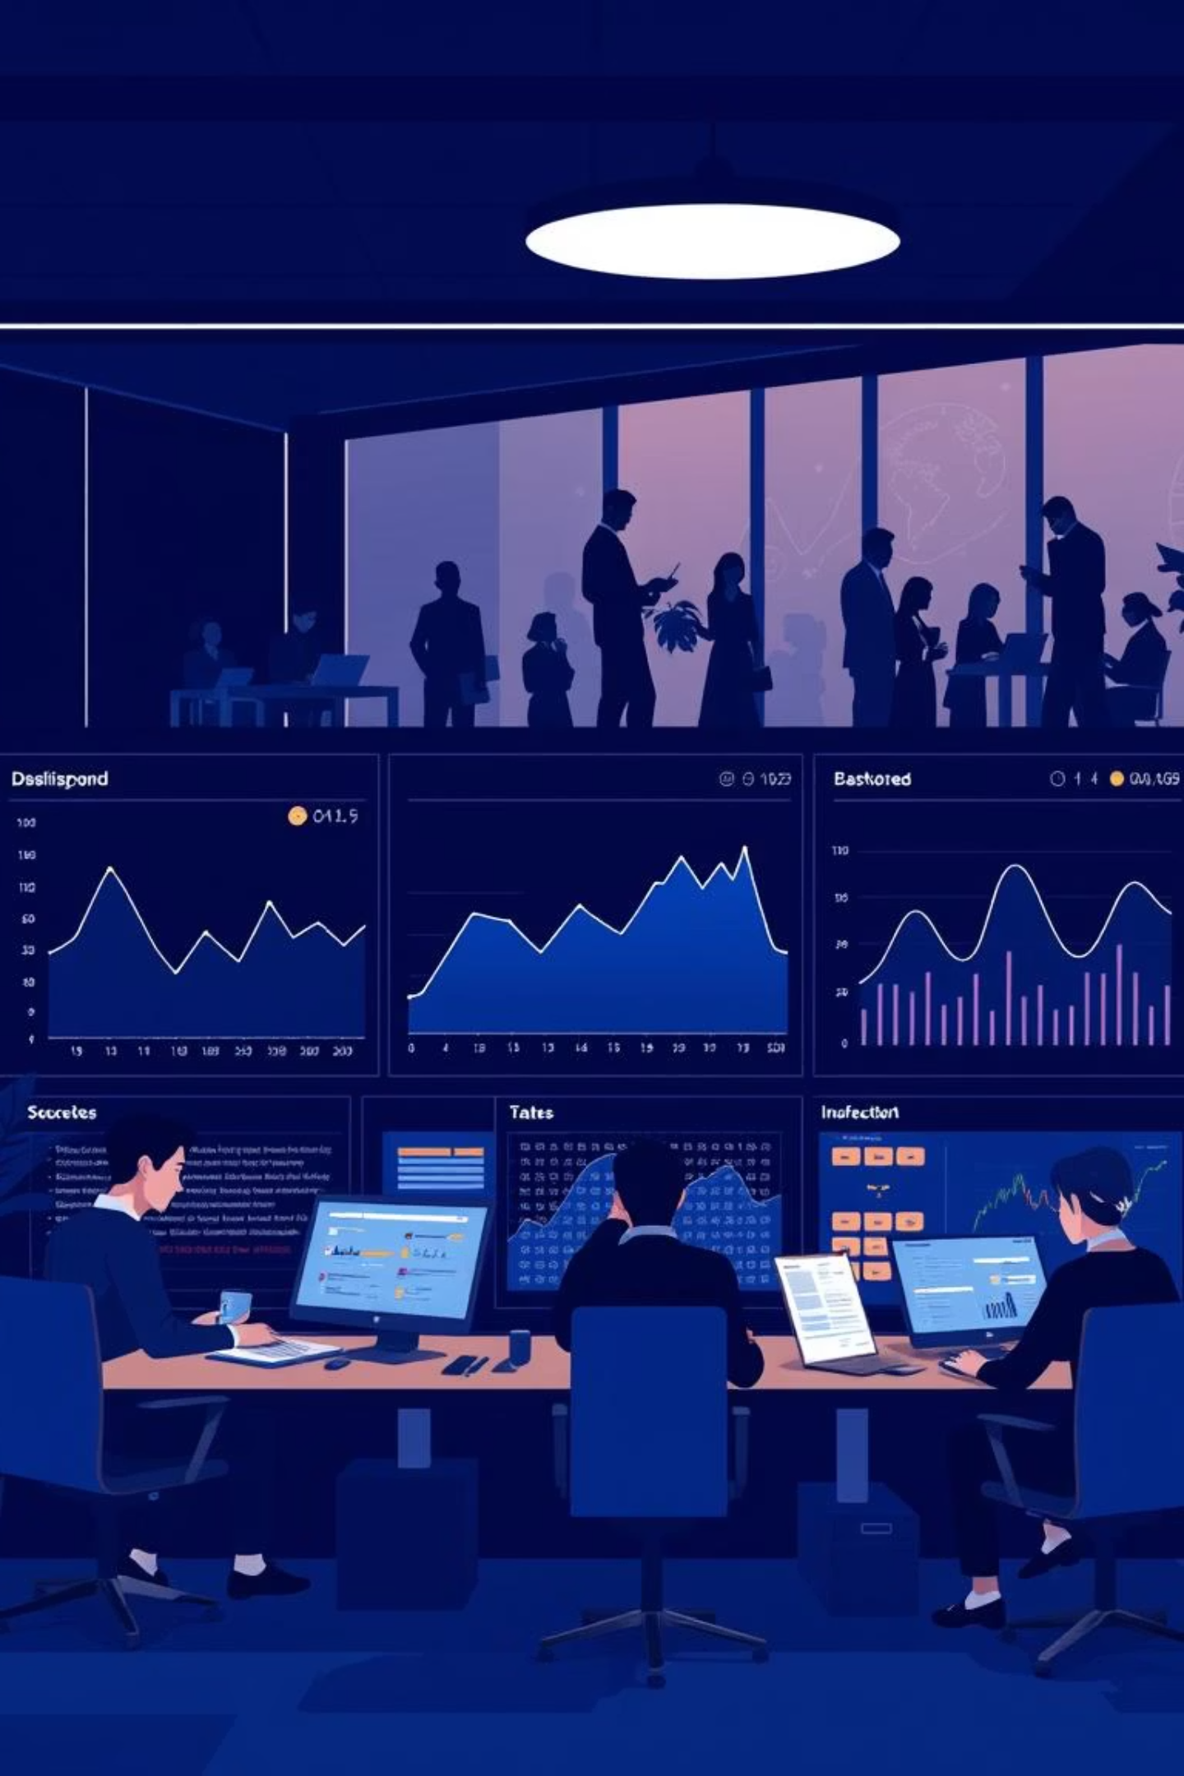
Employee Performance Analysis Dashboard
2410030313 - P. Bharath
2410030052 - G. Chandrakanth
2410030419 - S. Thanveesh
2410030462 - T. Nishanth

Slide 2
Driving Growth: Expected Outcomes
Smarter Decisions
Boosted Engagement
Early Warnings & Recognition
Leaders can base promotions and rewards, ensuring fairness and accuracy.
Employees receive clear, ongoing feedback, which drives motivation and continuous improvement.
Instant alerts help spot and fix issues promptly, while top performers are quickly recognized and rewarded.
Less Manual Work
Better Retention
Automated reports replace tedious HR tasks, saving valuable time and reducing human errors.
At-risk employees are identified early, allowing for personalized support to keep teams engaged and reduce turnover.

Slide 3

THANK YOU

